Slide 1

Sentence embeddings Applications in scientific paper classification and clustering
Purvil Patel
Atharva Jadhav
Sangram Jagtap
Omkar NagarKar
CMPE 255 Data Mining

Slide 2
Contents
Project Overview
Word Embeddings
Sentence Embedding
Distance Measures
Clustering
Preliminary implementation and results

Slide 3
Project Overview

Slide 4
Current Scientific Paper Lookup System
Systems to search research papers exist
ArXiv-Sanity Checker
Google Scholar
By topic modeling LDA, LSI
By keywords

Slide 5
Drawbacks of current methods
By keywords
Error Prone
Has no Semantic Meaning
No equivalence between semantically equivalent terms
No Classification by Paper Content

Slide 6
Proposed Scientific Paper Clustering
Unsupervised Clustering
Abstract Comparison
Semantically similar
Not just keyword tagging
Similar in application and content
Different subtopics under the same topic
Metadata extraction
Lookup on Metadata

Slide 7
Drawbacks vs. Proposed Solutions
Drawbacks | Proposed Solution
No semantic Meaning | use of word/ sentence embedding
Similarity by keywords | use of sentence embedding
No equivalence between semantically equivalent terms | cosine/ L2 norm for similarity
No Classification/ clustering by Paper Content | Classification/ clustering based on vectors of the test

Slide 8
Objectives of Project
To Extract Abstracts for various papers and preprocess dataset for embedding
To Create Word Embedding of the Paper Abstracts
To Create Sentence Embeddings for Paper Abstracts
To Create clustering models based on sentence embeddings
To Create the generic pipeline composed of above components, to be used for further evaluations of shortlisted models
To implement similarity operator for Sentence Embeddings, to find similar paper abstracts based on the clusters
Notes:
Our project focuses on enhancing text analysis in scientific papers. We aim to extract and preprocess paper abstracts, then create word and sentence embeddings from them. This will help us develop clustering models to categorize texts effectively. Additionally, we're building a pipeline for evaluating these models. A significant part of our work involves benchmarking these models, with half of this already achieved. Finally, we plan to implement a similarity operator for sentence embeddings to identify similar paper abstracts, enhancing research connectivity and insights.

Slide 9
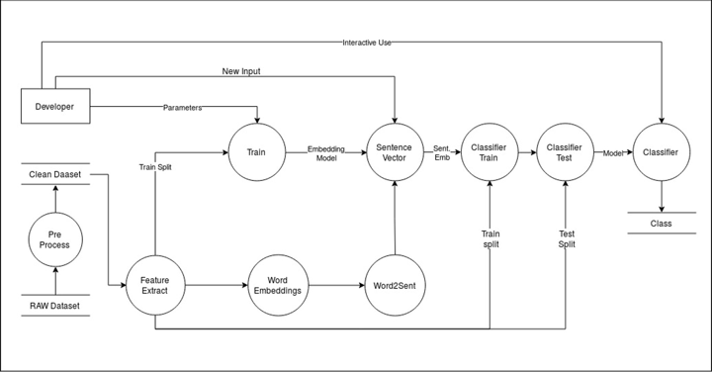
Project Pipeline Overview
Notes:
Extracted the relevant feature such as the id title , abstract
25 classes

Slide 10
Research Components
Components | Our Approach | Info
Word Embedding | Word2Vec (100d, 300d) | Wikipedia text
 | Glove (50d, 300d) | Wikipedia Text
 | FastText (100d, 300d) | Wikipedia Text
Sentence Embedding | Bag of Words | -
 | Power means | p = 1, min, max, 2, 4
 | USE | Google news dataset
Clustering | K-Means | Trained on sentence embeddings
 | DBSCAN | Trained on sentence embeddings

Slide 11
Word Embeddings

Slide 12
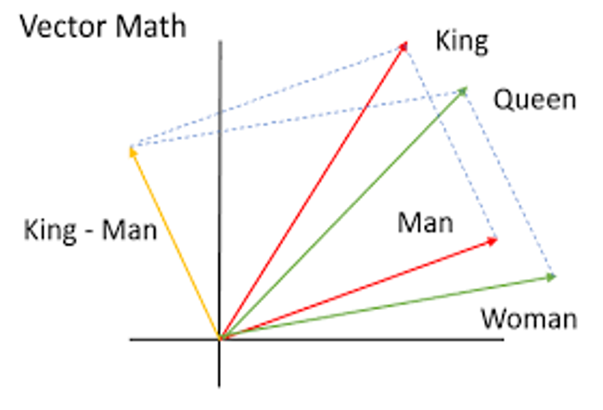
Word Embeddings
Word embeddings are vector representations of a particular word.
They are capable of capturing context of a word in a document, semantic and syntactic similarity, relation with other words, etc.
Vectors of semantically similar words are closer to each other
This closeness in vectors can be measured by various distance measures like cosine distance, manhattan distance, etc.
Notes:
Word embeddings turn words into vectors, capturing how a word is used and its meaning. They help understand words' context and how similar they are to other words. Words with similar meanings have vectors that are close together. We can measure this closeness using different methods, like cosine or Manhattan distance. This helps in understanding and comparing words better.

Slide 13
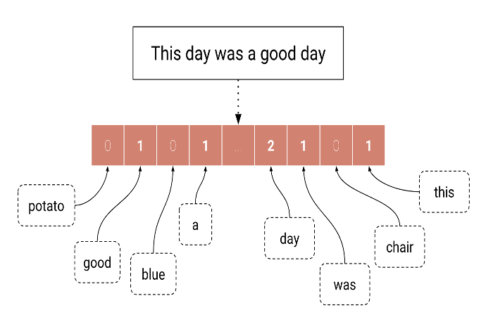
Critical Analysis of Word Embeddings
●Embed a full sentence into a vector space.
●Inherit features from their underlying word embeddings.
●Used to capture similarity between sentences, predict text and classify.
●Sentence embeddings are created by different methods such as Bag of Words, Power Mean etc.

Slide 14
Sentence Embeddings

Slide 15
Sentence Embedding
Algorithms
BoW + Power Mean
Universal Sentence Encoder
Infersent
Andreas Ruckle, Steffen Eger†, Maxime Peyrard, Iryna Gurevych
@ Technical University of Darmstadt
Daniel Cera, Yinfei Yanga, Sheng-yi Kong et al. @ Google Research
Alexis Conneau, Douwe Kiela et al.
@ Facebook Research

Slide 16
Distance Measures

Slide 17
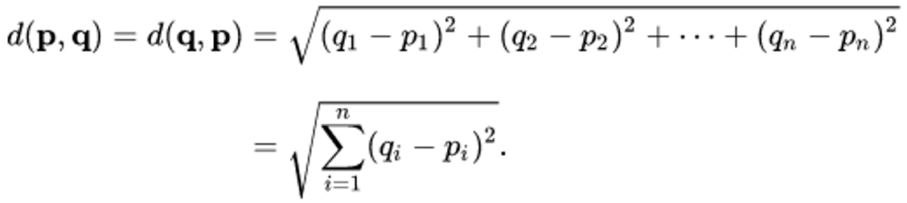
Euclidean Distance
In mathematics, the Euclidean distance or Euclidean metric is the "ordinary" straight-line distance between two points in Euclidean space.

Slide 18
Cosine Similarity
Cosine similarity is a measure of similarity between two non-zero vectors of an inner product space that measures the cosine of the angle between them.
The cosine of 0° is 1, and it is less than 1 for any angle in the interval (0, π] radians.
It is thus a judgment of orientation and not magnitude: two vectors with the same orientation have a cosine similarity of 1, two vectors oriented at 90° relative to each other have a similarity of 0, and two vectors diametrically opposed have a similarity of -1, independent of their magnitude.

Slide 19
Clustering

Slide 20
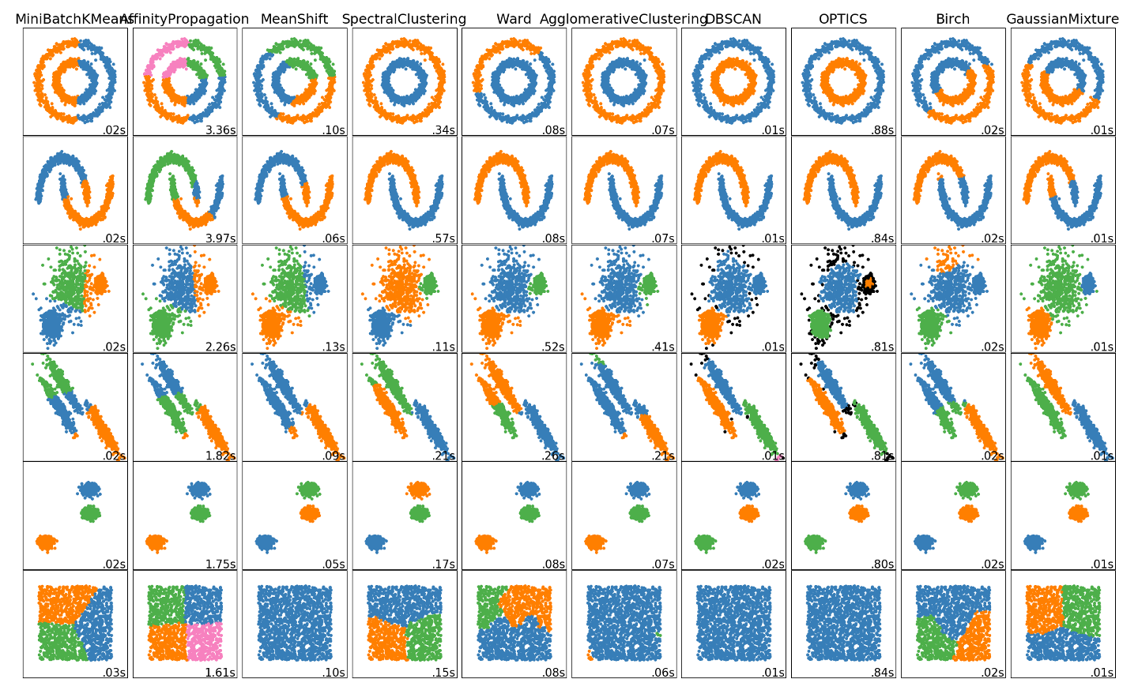

Slide 21
Clustering
For our research we have short listed following clustering methods:
K Means - Partitions a dataset into K distinct clusters by minimizing the distance between data points and cluster centroids.
DBSCAN - Identifies clusters based on high-density areas, differentiating core points, border points, and noise.

Slide 22
Preliminary Implementation

Slide 23
Preliminary Testing
In the first iteration of the code we have utilised the following conditions:
Sentence Embedding using Power means and word embeddings
Word embeddings using Glove, word2vec and fasttext
Get sentence embedding of the entire abstract at once as one sentence
Cluster Abstracts based on sentence embeddings

Slide 24
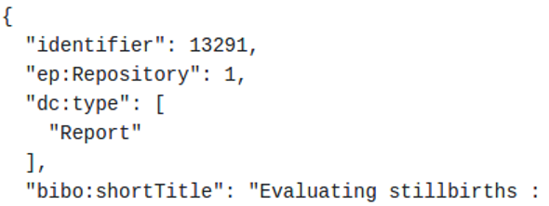
Dataset Description
Dataset downloaded from core.ac.uk
22 attributes in the raw dataset separated by commas stored in json format
Each line of file is valid json format
After preprocessing the raw dataset, the required fields extracted are
Identifier
Title
abstract
Dataset file from 2013(189 MB) used, comprising of the following attributes eg:

Slide 25
Demo
https://github.com/AtharvaJadhav/CMPE255-Project-Clustering-Research-Paper-Abstracts

Slide 26
Project Structure
Github Repo Link: https://github.com/AtharvaJadhav/CMPE255-Project-Clustering-Research-Paper-Abstracts

Slide 27
Results

Slide 28
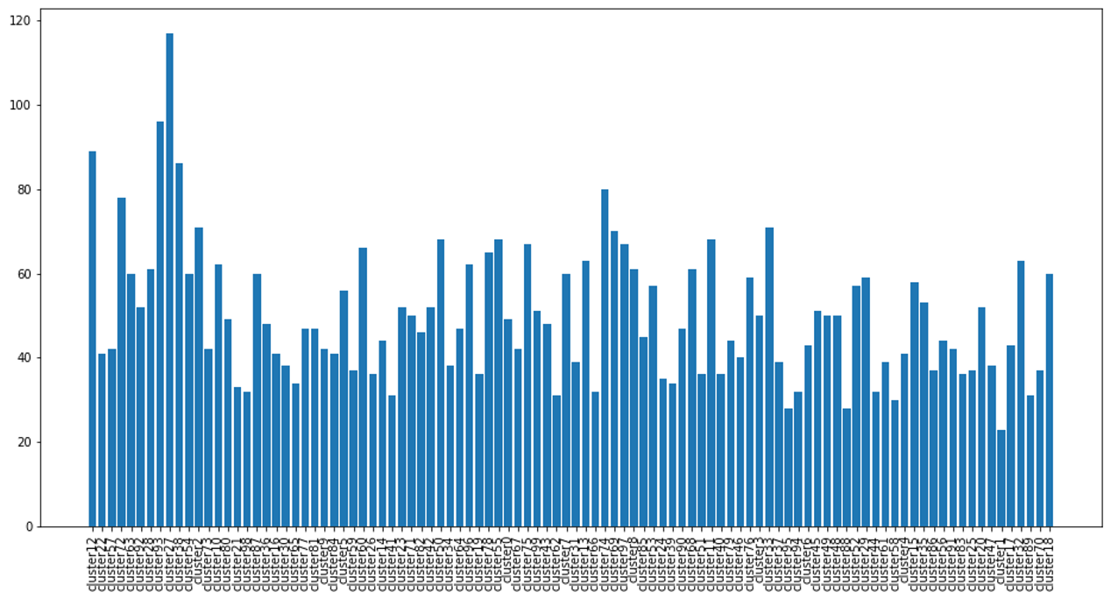
KMeans Results (# clusters = 100, # samples = 400,000)

Slide 29
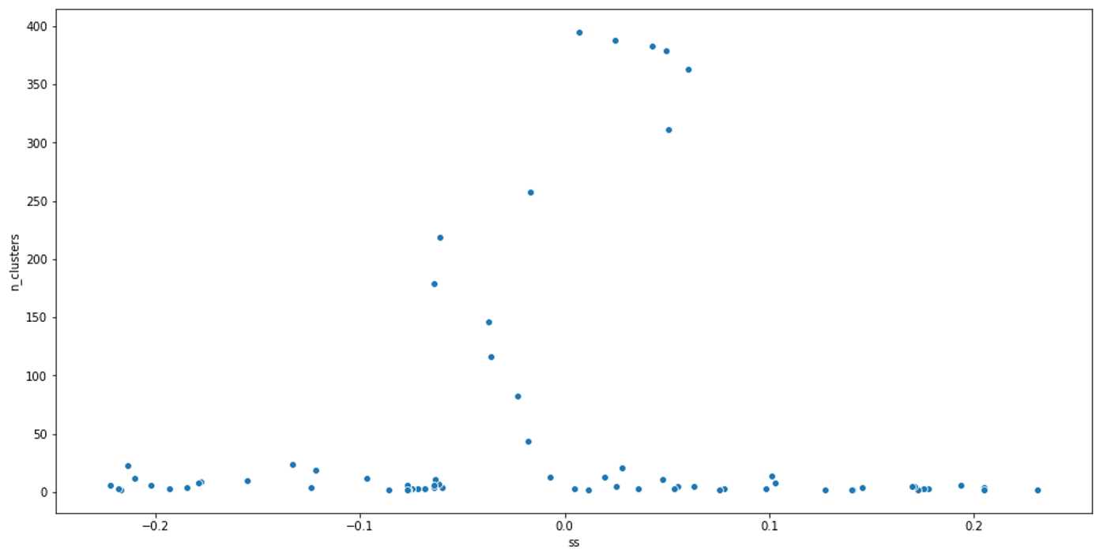
DBSCAN (No. of Clusters VS. Silhouette Score)

Slide 30
Preliminary testing
From our comparison of KMeans and DBSCAN we choose kmeans due to:
Pros of Kmeans | Cons of DBSCAN
gives uniformly distributed samples of high dimensionality based on euclidean distance. | many points remain unassigned based on the model parameters
experimentally we can easily find the k which gives a uniform distribution | difficult to get the right parameters Many parameter pairs do not give satisfactory number of clusters and silhouette score

Slide 31
Prelimininary Results of Abstract Clustering
We implemented abstract clustering on the various iterations of models having following parameters
Model : K-Means
DIfferent Parameters
K - Number of clusters
R - Number of Records/Abstracts
F - Number of features
Cluster Distributions are shown in the following slides

Slide 32
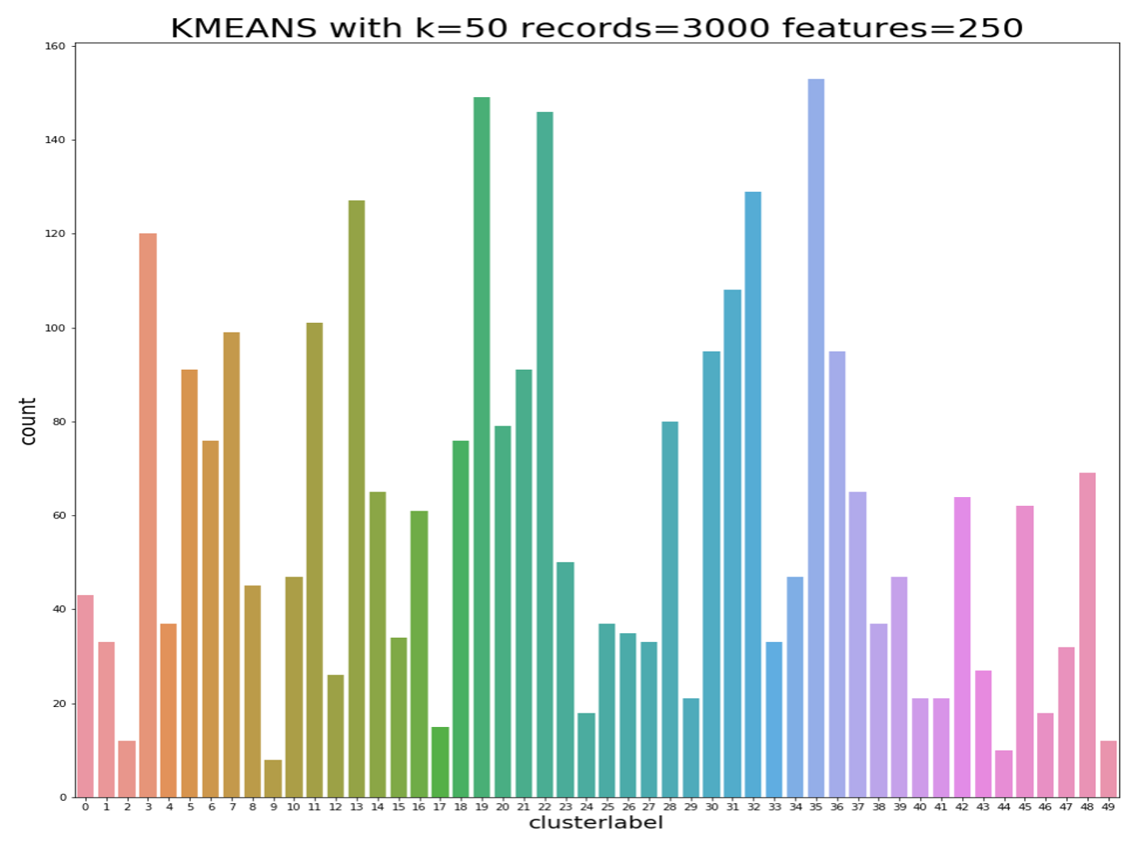

Slide 33
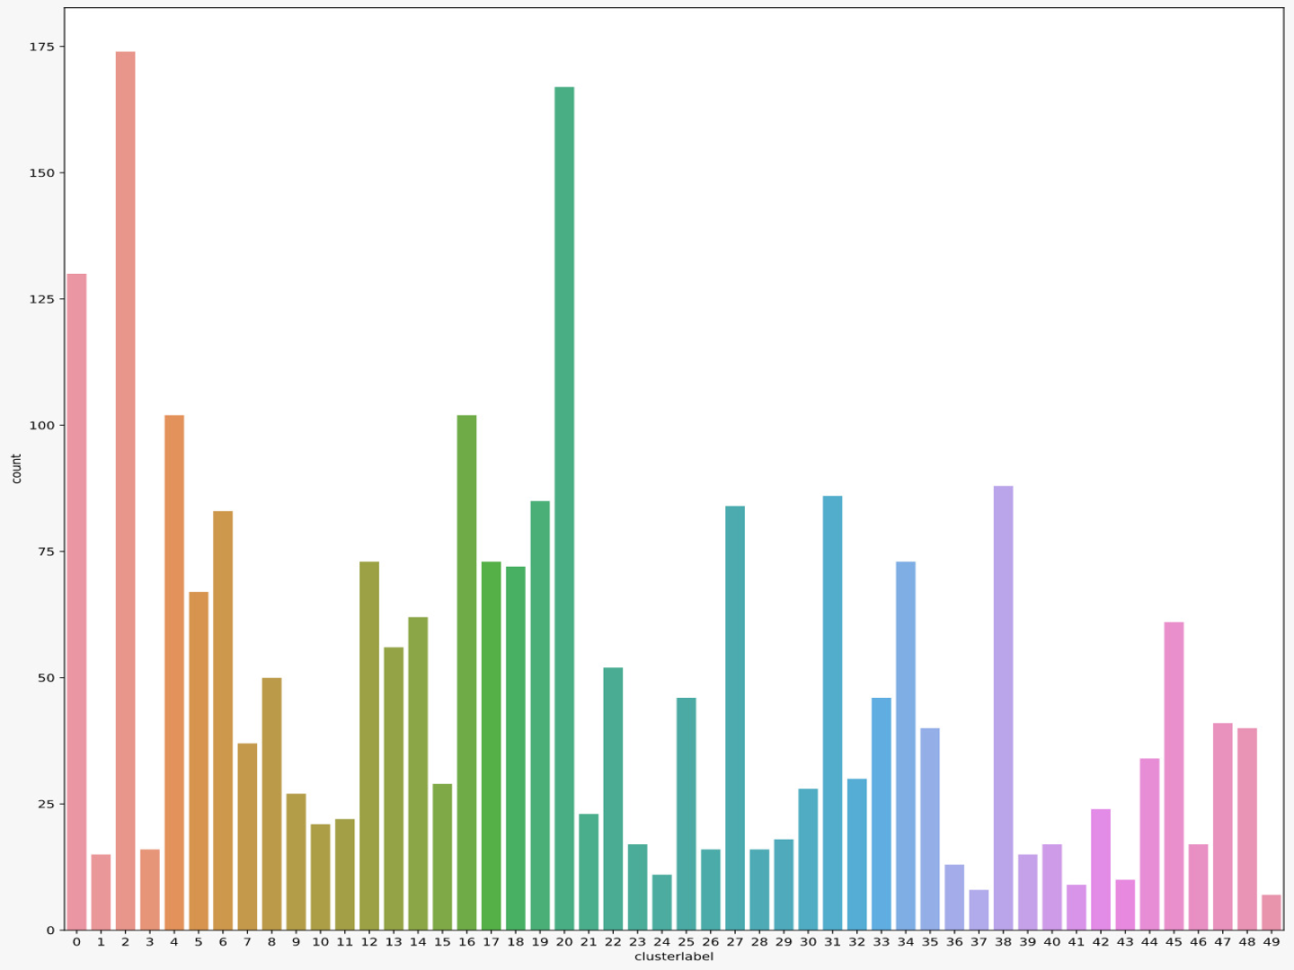

Slide 34
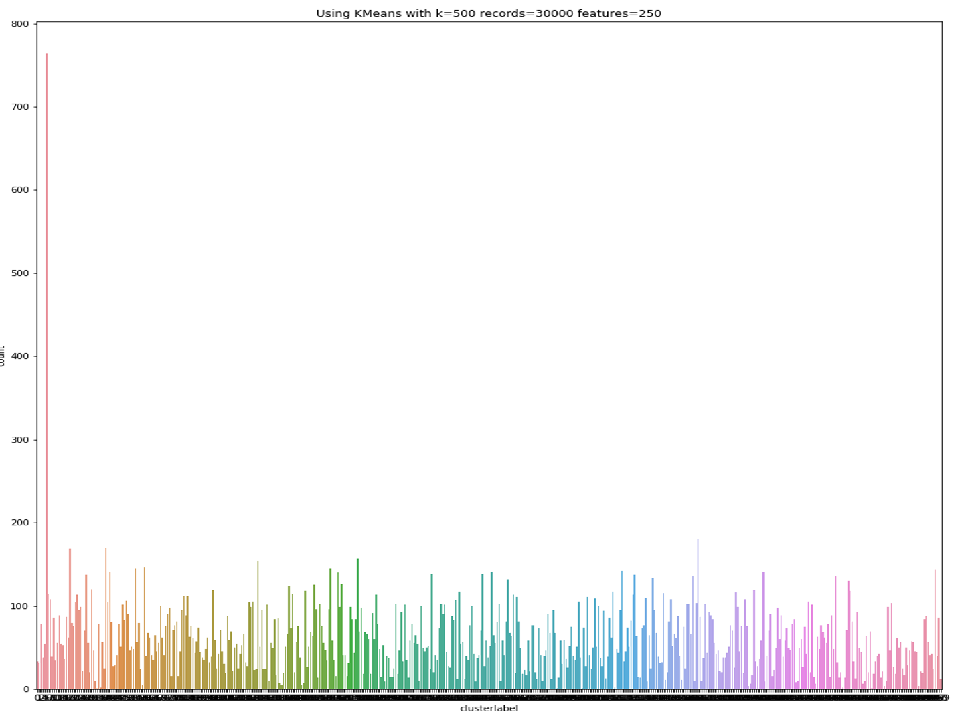

Slide 35
Upcoming Work
Explore further iterations of the current model
Explore USE in place of p-means
Explore ways of giving similar papers based on the clustering

Slide 36
Progress Summary
To Extract Abstracts for various papers and preprocess dataset for embedding ✔️
To Create Word Embedding of the Paper Abstracts ✔️
To Create Sentence Embeddings for Paper Abstracts ✔️
To Create clustering models based on sentence embeddings ✔️
To Create the generic pipeline composed of above components, to be used for further evaluations of shortlisted models ✔️
Benchmark proposed models and components using the Pipeline (50% done) ✔️
To implement similarity operator for Sentence Embeddings, to find similar paper abstracts based on the clusters ✔️

